Slide 1
Introduction to Data Analytics Spring 2023
Lecture 1

Slide 2


Welcome!
Notes:
Use this slide to get to know each other! (Both, teachers and learners)
Invite everyone to introduce themselves and tell shortly
where they are from and why they are in Denmark.

Slide 3






How we work
Lectures
17:30 - 18:45
80% attendance required
Ask questions!
Exercises
19:00 - 20:30
Be active! Make mistakes!
Homeworks
Hand-in until Monday
Individually on Google Classroom
Kahoot Quiz!
Every second week
Communication
Slack! Keep up to date!
Project
Talk to your mentor
Notes:
Lectures: Slides on Google Classroom
Times may vary
15 minute break
Exercises: Assistants and teacher help with issues
Homework: Helps us see where you struggle
Helps you get feedback
Kahoot: Fun activity
Maybe prizes?
Communication: Install the app, so you get notifications
Project: We only help with programming knowledge

Slide 4
Setup
Checklist
Do I have access to Google Classroom?
Do I have access to the Slack channel #data-analytics-team-4?
Do I have Kahoot installed?
Do I know who is in my team?
Did I complete the Python Installation Guide?
Am I ready for class?

Slide 5
A few words of advice

Slide 6
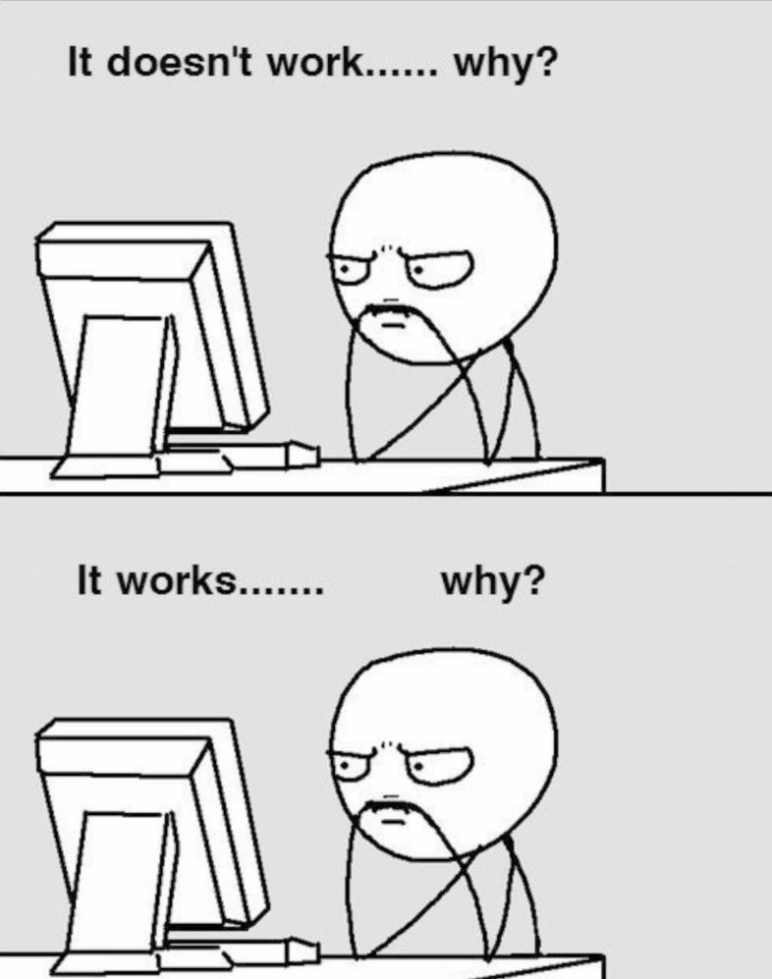
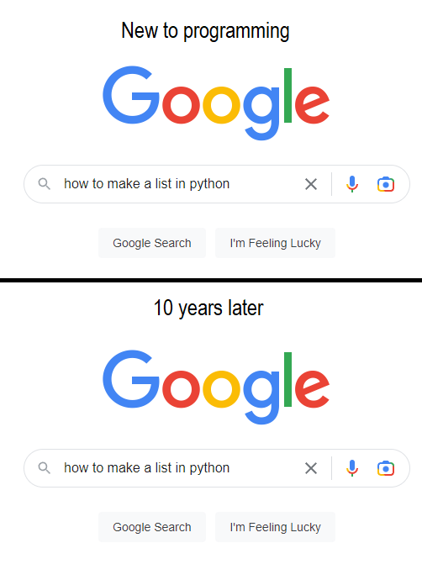
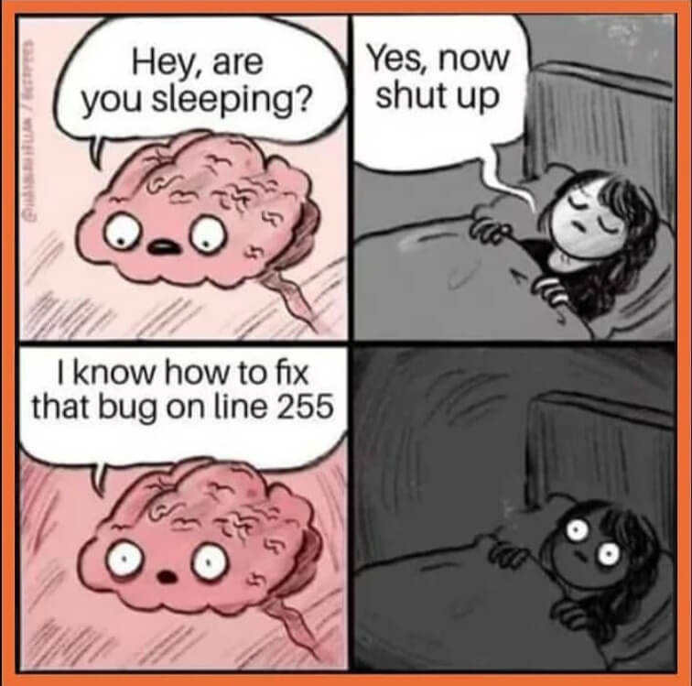
Mantras
Understand your code!
Learn how to Google!
Take a break!

Slide 7
Dunning-Kruger effect
Peak of Ignorance
Plateau of Expertise
Confidence
Slope of Enlightenment
Valley of Despair
Knowledge
Notes:
Peak of Ignorance: aka. “Mt. Stupid”
Thinks it’s easy and they know all
Valley of Despair: Realises how little they know
Feeling overwhelmed by the amount of knowledge that exists
Easy to give up
Slope of Enlightenment: Focussed learning phase
Continuous growth
Discovers what they don’t know
Plateau of Expertise: Mastered the Concepts
Knows what they don’t know
Knows how/where to find out what they don’t know

Slide 8
The Essence of the course
The goal of this course is to teach you how to:
“Collect, transform, model, analyze, and visualize a broad range of datasets using Python and its open source libraries, through concepts of Data Analytics.”
Important: You are responsible for your own learning!

Slide 9
Let’s get started!

Slide 10
What is Data Analytics?

Slide 11
Purpose
“DATA SCIENCE is the process of building, cleaning, and structuring datasets to analyze and extract meaning.
DATA ANALYTICS refers to the process
and practice of analyzing data to answer questions, extract
insights, and identify trends.”
~Harvard Business School Online

Slide 12
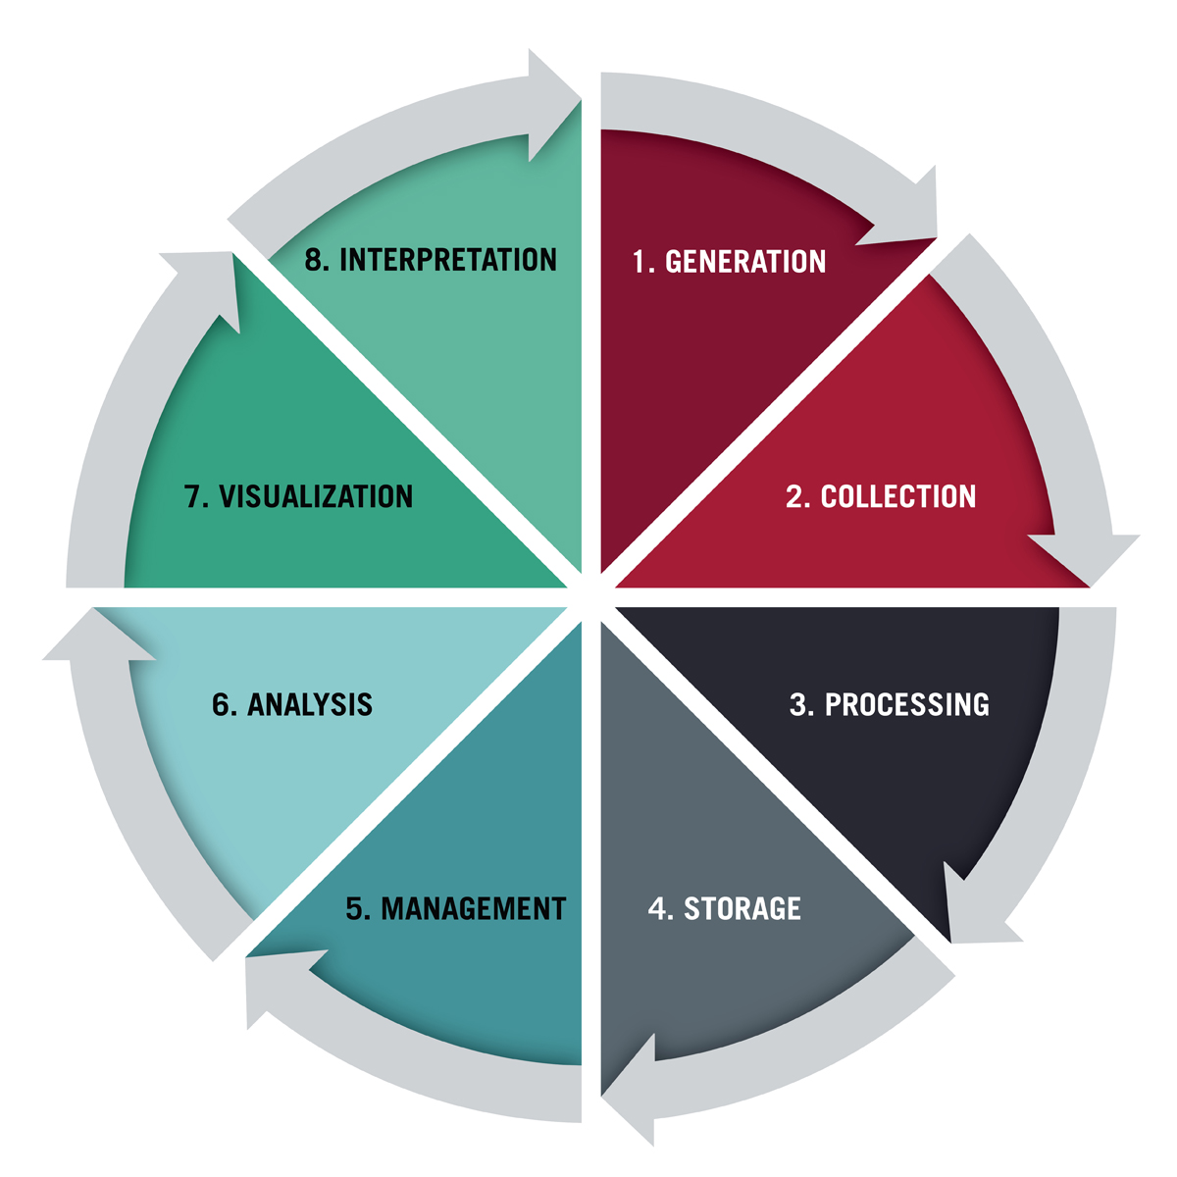
Data Ecosystem & Lifecycle
Data Ecosystem describes the tools and setup of an organisation to collect, store, and manage data.
Data Lifecycle describes the journey of data from when it is collected to when it interpreted.

Slide 13
The Programming Tools

Slide 14
What is Python?
“Python is a programming language that lets you work more quickly and integrate your systems more effectively.

Slide 15
Why Python for Data Analytics?
Easy to Learn and Use
Cross-Platform Compatibility (Windows, Mac, Linux, …)
Great Open Source Community
Modular With Many Libraries
Great Data- and Visualisation Tools
High Demand on the Job Market

Slide 16
Components of Programming in Python
Python language
Used to write the code
print('Hello, world!')
IDE
The editor in which the code is written
Visual Studio Code, Atom, Browser, Text Editor
Console / Terminal
The system tool in which the code is run
python main.py
python -m jupyterlab
PIP / libraries / packages
A repository of python software written by the open-source community
pip install jupyterlab
Notes:
Lectures: Slides on Google Classroom
Times may vary
15 minute break
Exercises: Assistants and teacher help with issues
Homework: Helps us see where you struggle
Helps you get feedback
Kahoot: Fun activity
Maybe prizes?
Communication: Install the app, so you get notifications
Project: We only help with programming knowledge

Slide 17
Python Packages
Math
Data Exploration
Data Visualisation
Environment
NumPy
Pandas
Matplotlib
Jupyter
SciPy
Dask
Plotly
Spyder
Scikit-learn
PySpark
Seaborn
Anaconda
TensorFlow
Altair
Bokeh
Cloud Solutions

Slide 18
Programming Basics

Slide 19
Data Types
Text
str “Hello, world” / “4”
Numeric
int -1 / 0 / 4 / 23
float -1.5 / 0.2 / 5.3
Iterable / Sequence
list [ “hello”, “world” ] [ 4, 2, 10 ]
tuple ( “apple”, “pear”, “pear” )
range range(1,10)
Mapping
dict {
“name”: “John”,
“lastname”: “Doe”,
“age”: 23
}
Unique collection
set { “apple”, “banana”, “pear” }
Boolean
Bool True, False
Null Type
NoneType None
Notes:
Lectures: Slides on Google Classroom
Times may vary
15 minute break
Exercises: Assistants and teacher help with issues
Homework: Helps us see where you struggle
Helps you get feedback
Kahoot: Fun activity
Maybe prizes?
Communication: Install the app, so you get notifications
Project: We only help with programming knowledge

Slide 20
Variables
“Variables are containers for storing data values."
A Variable has with a name, a type, and a value.
Writing to a variable is called “assigning to a variable”
Variables can be reassigned (overwrite)
Examples:
name = “Clara”
isStudent = True
age = 23
name = “Emma”

Slide 21
Operators
“Operators are used to perform operations on variables and values.”
Arithmetic
Assignment
Comparison
Logical
Membership
3+2
x = 3
x == y
x>3 and x<10
1 in [1,2,3]
2*3
x += 5
5 != 3
x<3 or x>10
2 not in [4,5,3]
12%3
x *= 2
3 > 5
x not 5
“Clara” not in [“Emma”, “Tom”]
2**3
x /= 3
5 <= 3
x not 3 && not 5
20 in [“20”, “25”]

Slide 22
Functions
“A function is a block of code which only runs when it is called.”
You can pass data, known as parameters, into a function.
A function can return data as a result.
Example:
print(“Hello, world”)
marks = [65, 71, 68, 74, 61]
print(sum(marks))

Slide 23
Break - Then it’s your turn!

